Slide 1
Review

Slide 2
JANUARY

Slide 3
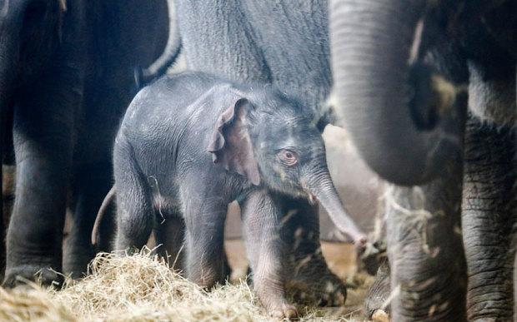
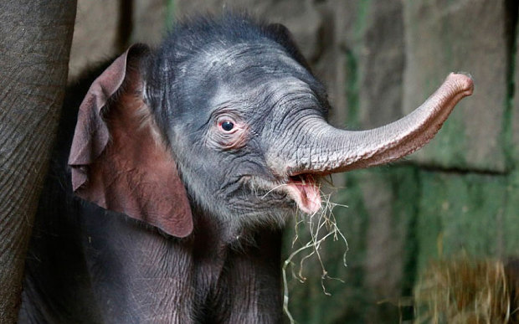
A new baby elephant was born in the Berlin Tierpark Zoo in Germany on New Year’s Eve.
The park-keepers were surprised by the early birth and hadn't predicted the arrival. She weighed 100kg.

Slide 4
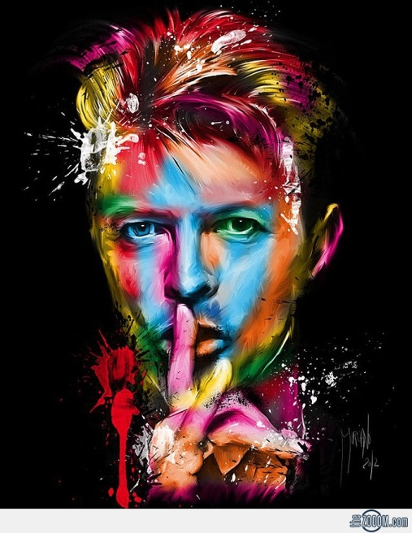
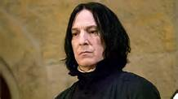
David Bowie, the famous rock star died from cancer in New York City on January 10th.
He was 69.
Alan Rickman followed him on January 14th, 2016.
Alan Rickman in Harry Potter and the Goblet of Fire
2005

Slide 5
FEBRUARY

Slide 6
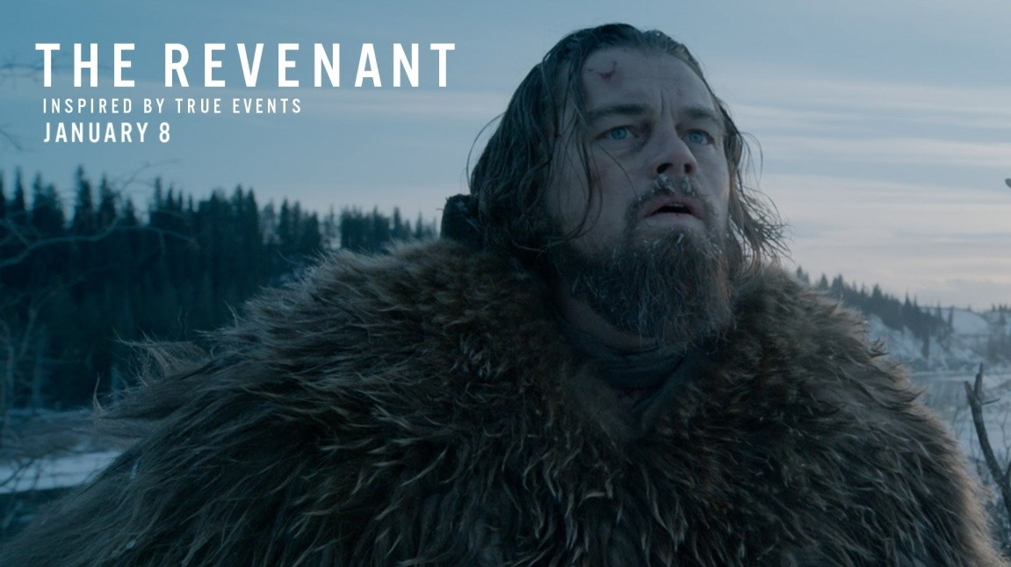
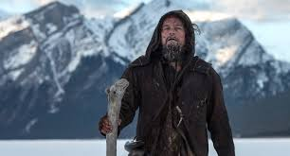
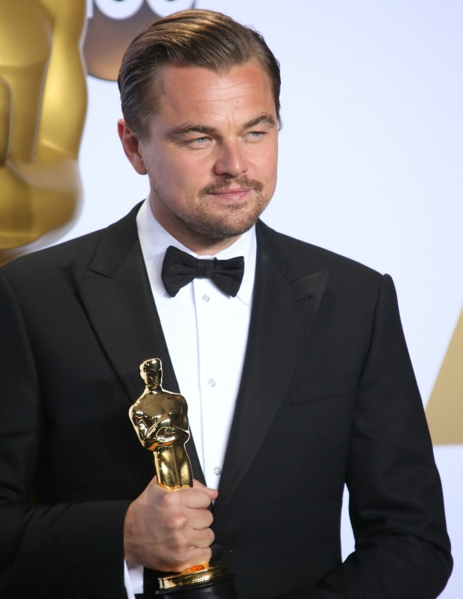
Leonardo Di Caprio
finally got his Best Actor Oscar for The Revenant on Feb 28th.

Slide 7
MARCH

Slide 8
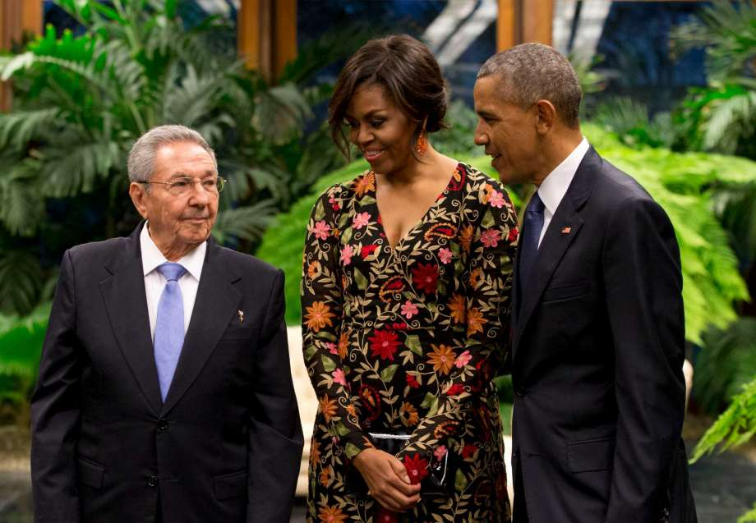
President Barack Obama went to Cuba to renew relations between Cuba and the U.S.A.

Slide 9
APRIL

Slide 10
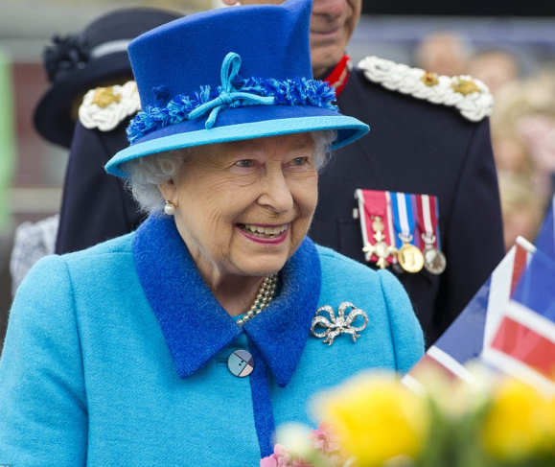
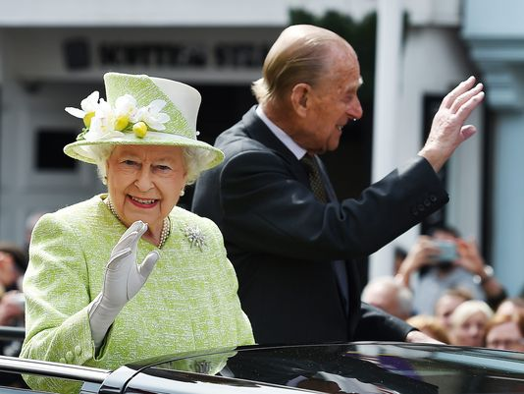
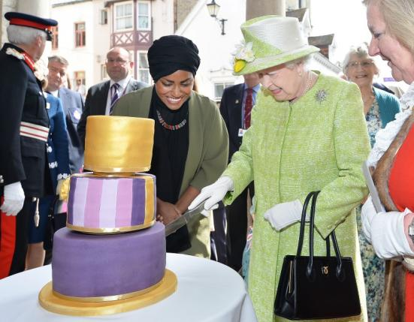
On April 21st Queen Elizabeth
celebrated her 90th birthday.

Slide 11
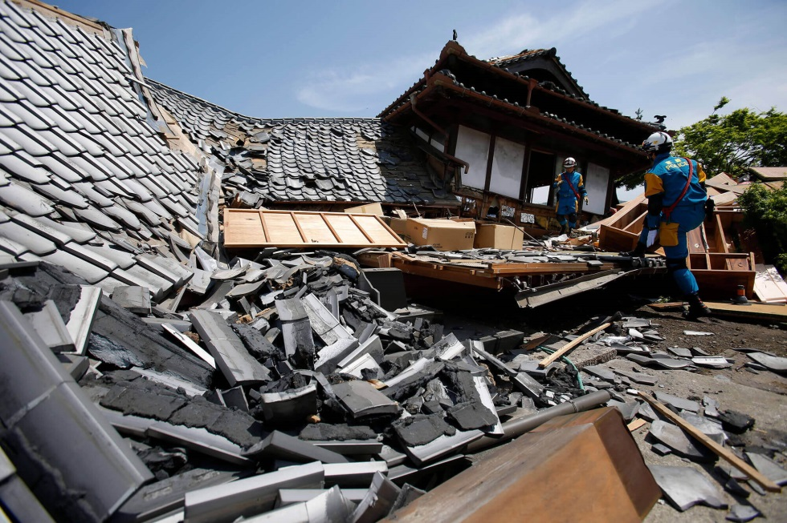
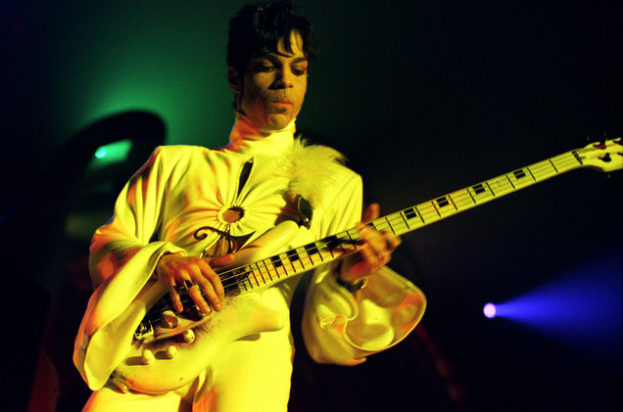
Series of earthquakes devastated Southern Japan.
A striking and influential funky star of the late 20th century, Prince died on April 21st.

Slide 12
MAY

Slide 13
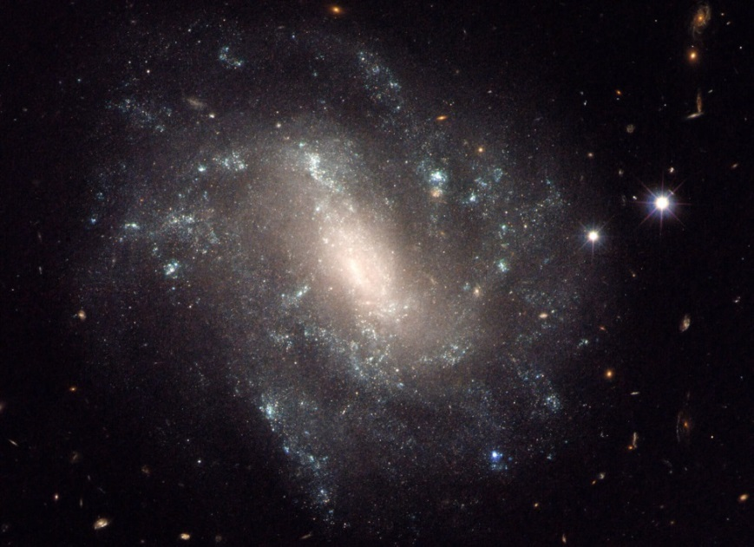
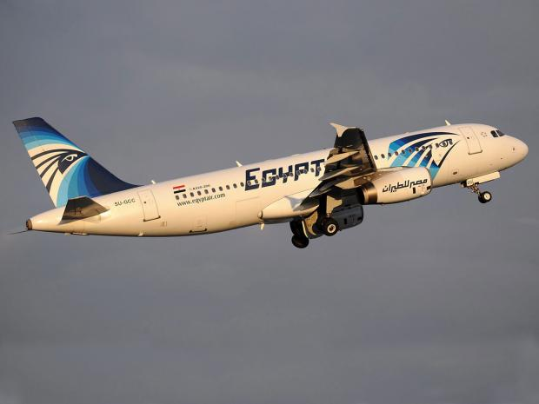
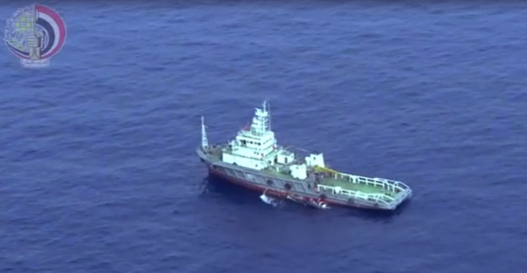
NASA announced the discovery of 1,200 new planets on May 10th, 2016. It was made thanks to the Kepler telescope and doubled the amount of known planets in the galaxy.
On May 19th Egypt Air plane disappeared during its journey from Paris to Egypt. There were 66 passengers on board.

Slide 14
JUNE

Slide 15
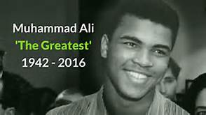
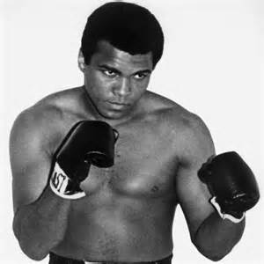
MuhammadAli (born Cassius Clay) was a legendary boxer. He won the world heavyweight title on three occasions and a gold medal at the 1960 Olympics in Rome. He died on June 3rd.

Slide 16
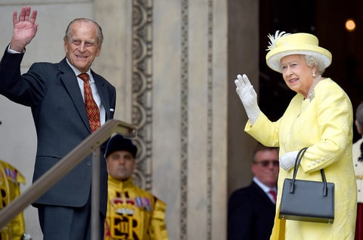
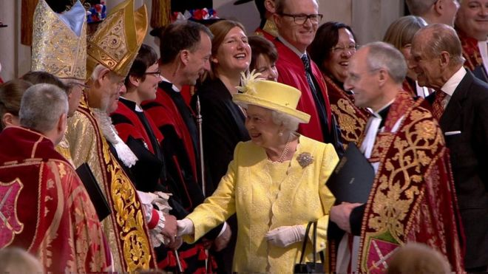
From June 10th to June 12th there was an official celebration for the Queen’s 90th birthday. It started with a Service of Thanksgiving at St Paul’s Cathedral

Slide 17
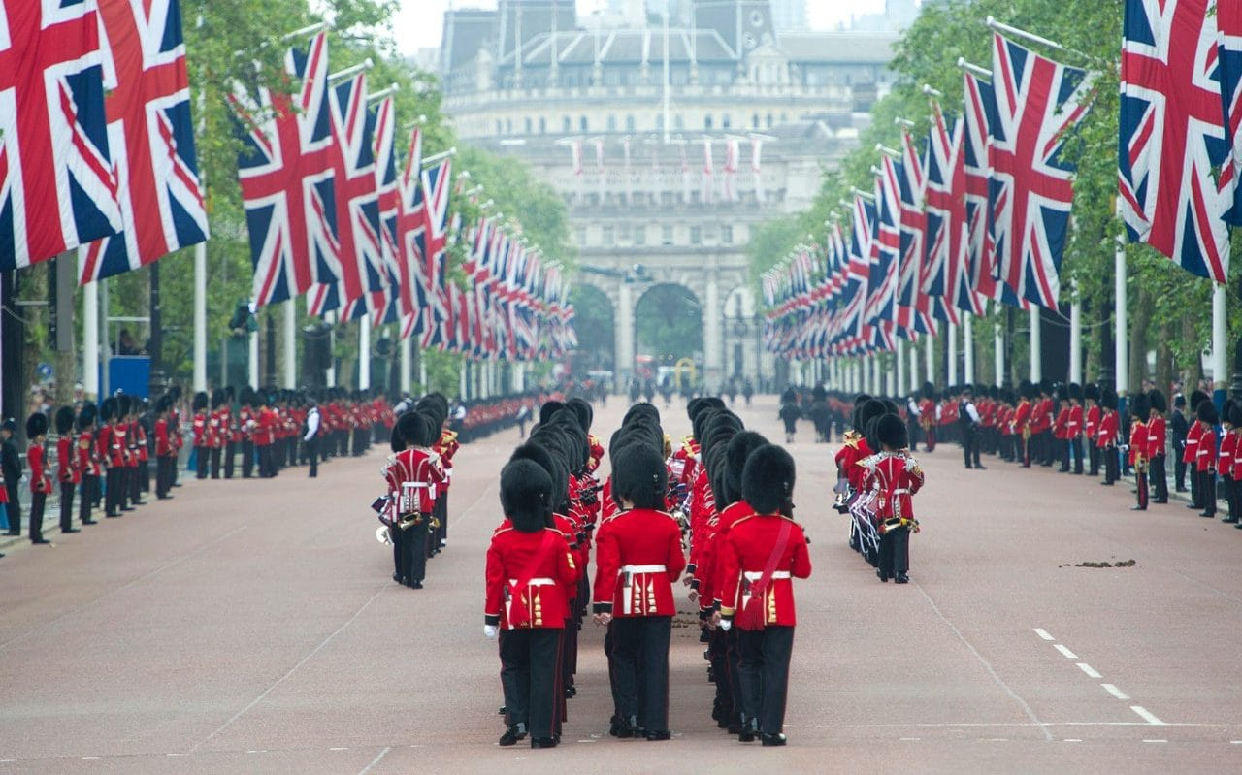
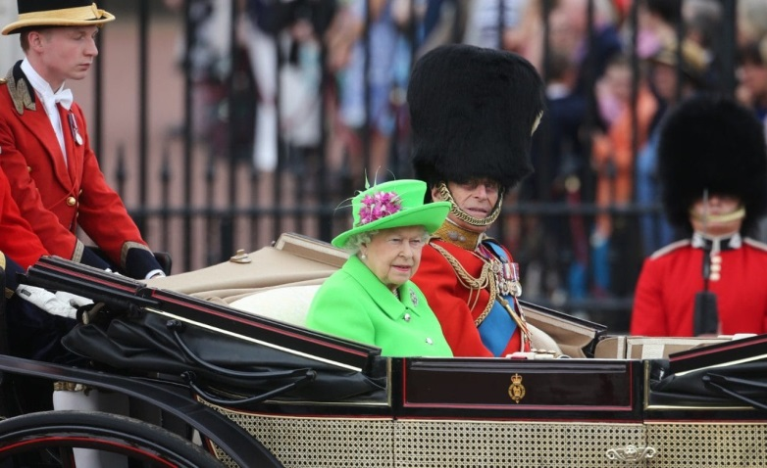
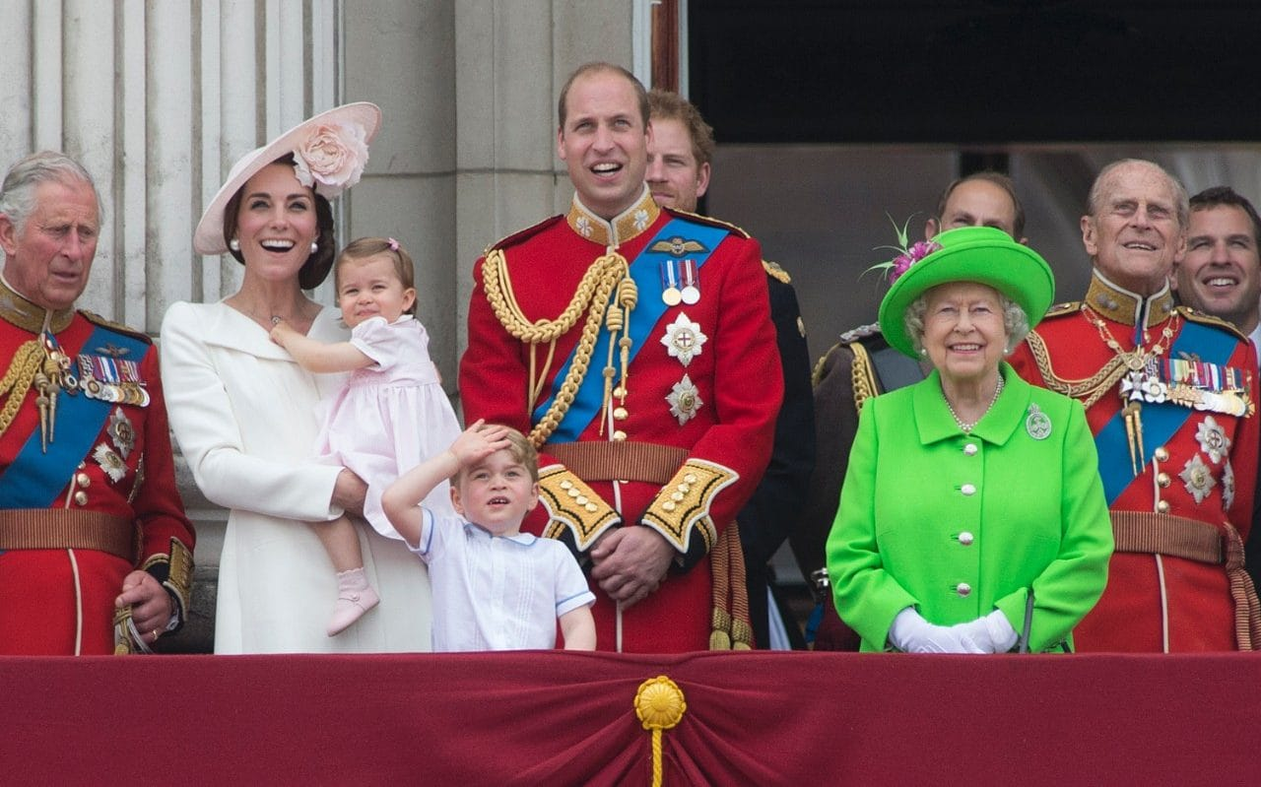
Then on Saturday 11th the Queen’s birthday parade took place : « Trooping the Colour » during which she inspected the soldiers from the Household Division.

Slide 18
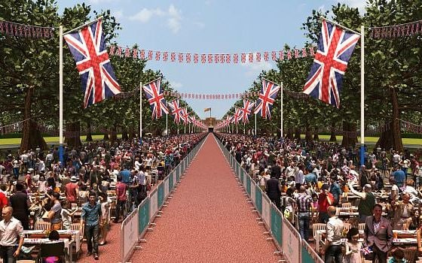
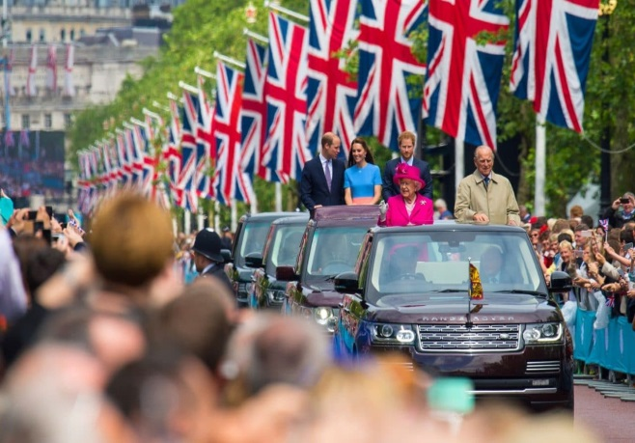
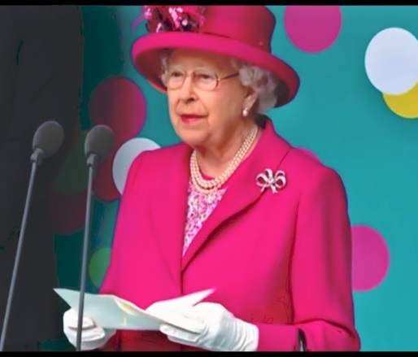
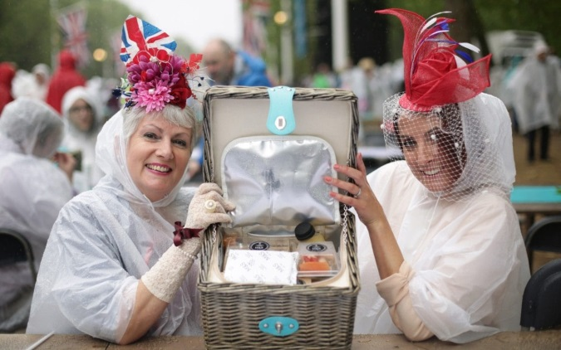
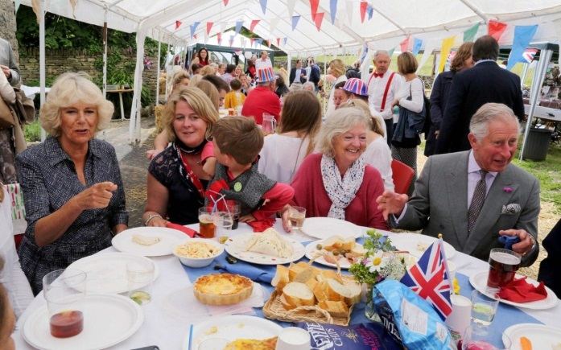
On June 12th The Mall in London was transformed into a Giant Street Party for the Patron’s Lunch. 10,000 guests ate a picnic lunch. The Queen and the Duke of Edinburgh took part in the event from a platform in front of Buckingham Palace.
Street parties were held all over the country.

Slide 19
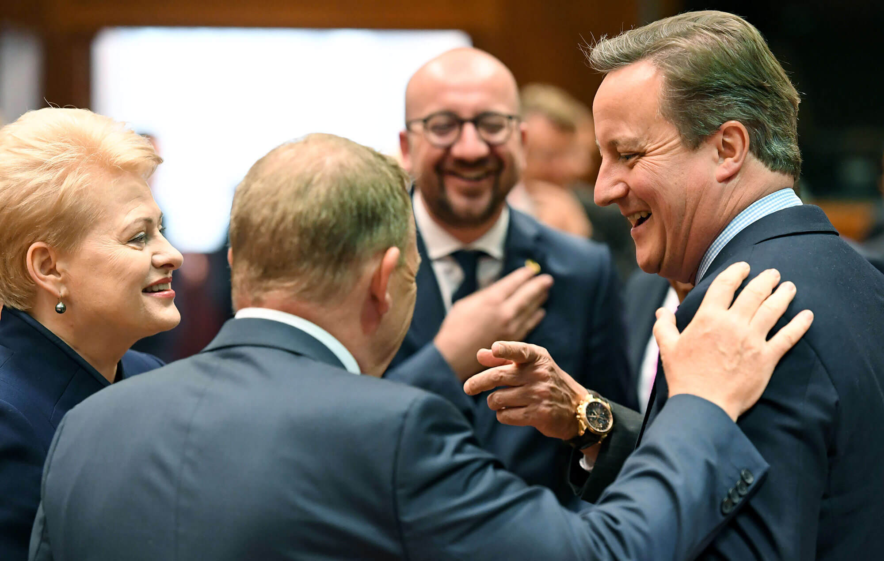
Brexit Vote
The United Kingdom was officially set to leave the European Union. Prime Minister David Cameron resigned.

Slide 20
JULY

Slide 21
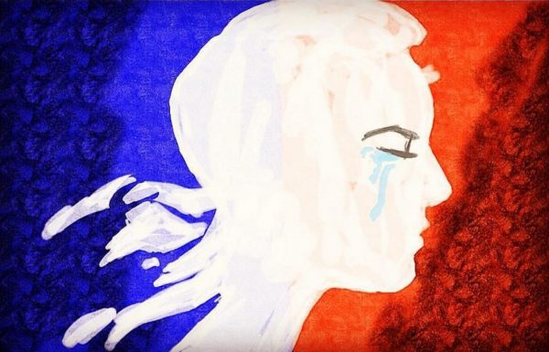
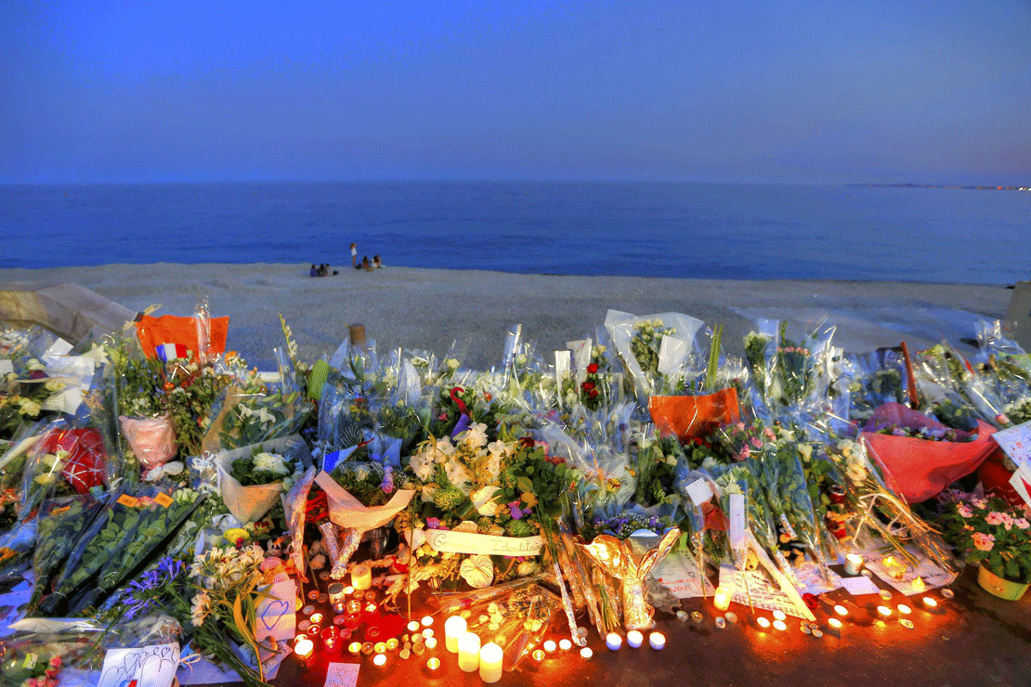
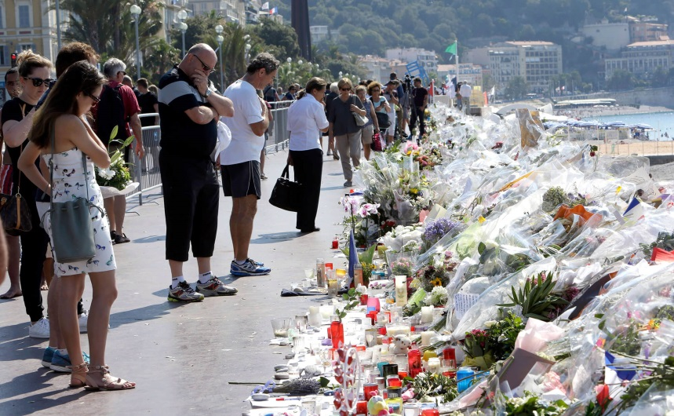
Tragedy struck France again on Thursday, July 14, 2016. The country was celebrating its most important holiday, Bastille Day, when a large truck drove through a crowd in the southern city of Nice, France. The truck fatally crushed 84 people and injured more than 200, children included. The driver was shot and killed by police officers responding to the attack.

Slide 22
AUGUST

Slide 23
From August 5th to August 11th the Olympic Games took place in Rio De Janeiro, Brazil. France won 42 medals, Germany 42 too and Great Britain got 67 medals.

Slide 24
SEPTEMBER

Slide 25
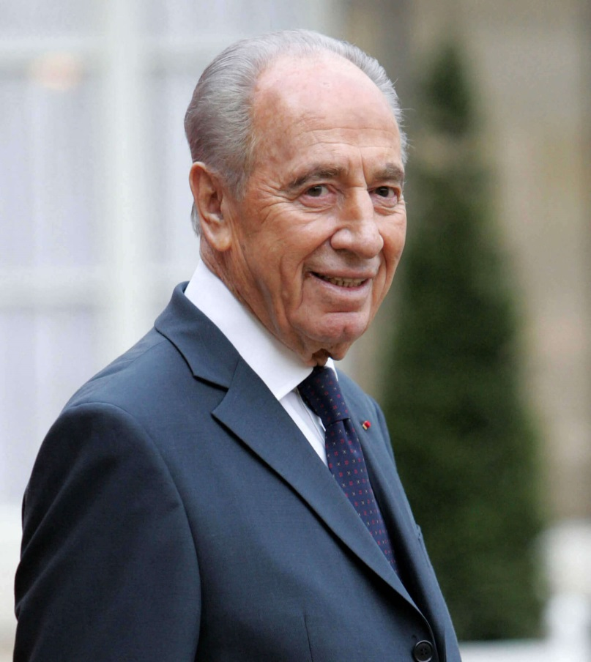
Shimon Peres, the former president and prime minister of Israel died on Wednesday, Sept. 28, 2016. He was a beloved leader of Israel, He constantly pushed his country toward peace, won the Nobel Peace Prize in 1994. President Obama offered his condolences: "….. A light has gone out, but the hope he gave us will burn forever."

Slide 26
OCTOBER

Slide 27
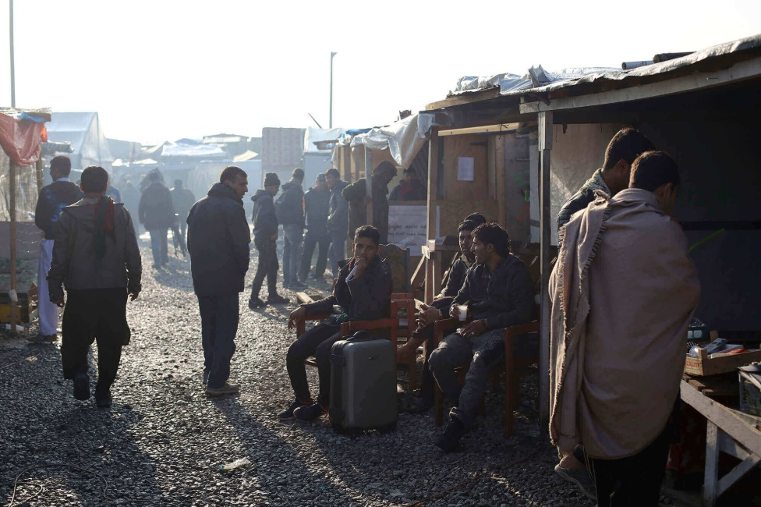
Monday Oct. 24, 2016, France officially closed down the migrant camp known as "The Jungle." Due to the poor conditions in the camp, "The Jungle" became a symbol for the failing efforts in Europe to help migrants. Before Monday the camp's population was somewhere between 6,000 and 8,000 migrants, many from conflict-torn countries. The refugees lined up to board buses, taking them to temporary housing units throughout France.

Slide 28
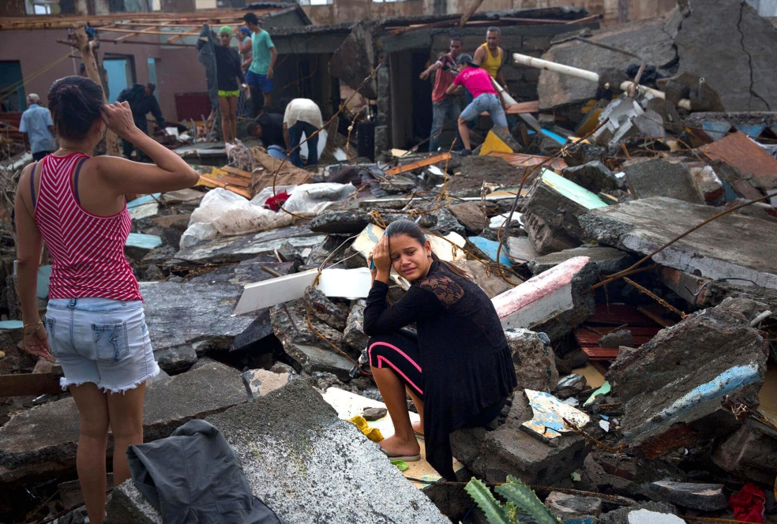
On October 4, 2016 Hurricane Matthew hit the island of Haiti as a level 5 hurricane, the highest level a hurricane can achieve. It destroyed thousands of homes and infrastructure throughout Haiti.

Slide 29
NOVEMBER

Slide 30
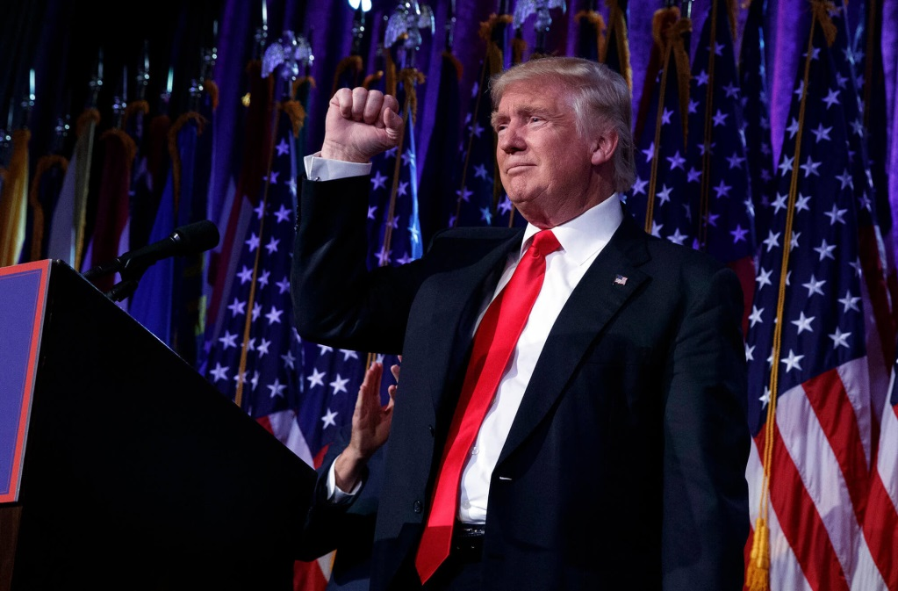
Donald Trump won the 2016 U.S.presidential election held on Nov. 8, 2016. He will be the 45th president of the United States, to be inaugurated in Jan. 20, 2017.

Slide 31
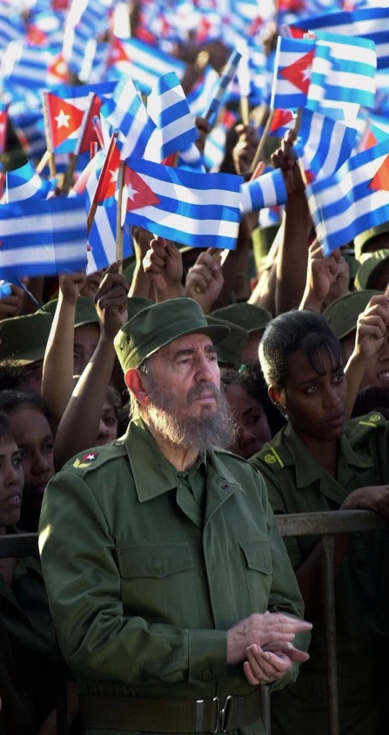
On Nov. 25, 2016, Fidel Castro died at the age of 90. Castro was the revolutionary communist leader of Cuba for almost five decades. During his time in power he helped lower illiteracy rates, infant mortality rates, and started a national healthcare system. However, he failed to bring prosperity and had no tolerance for dissent, jailing thousands of people.

Slide 32
DECEMBER

Slide 33
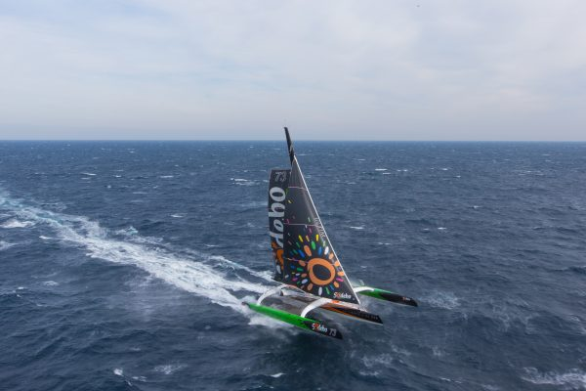
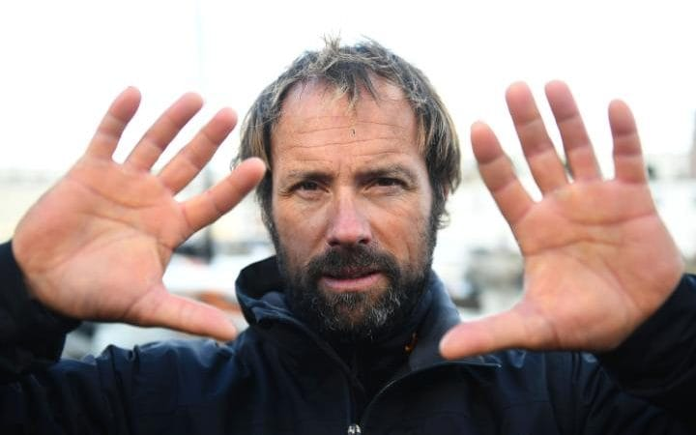
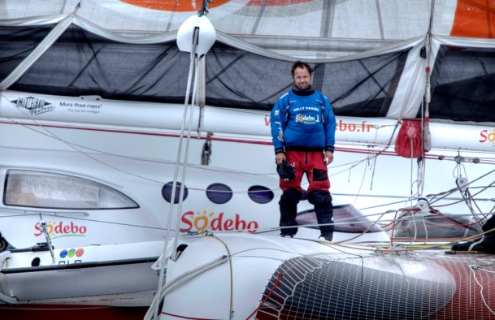
On Christmas day
The French skipper Thomas Coville beat the record in solo non-stop round the world sailing. He ended in just 49 days 3 hours 7 min. 38 sec.
Well-done Thomas !!

Slide 34
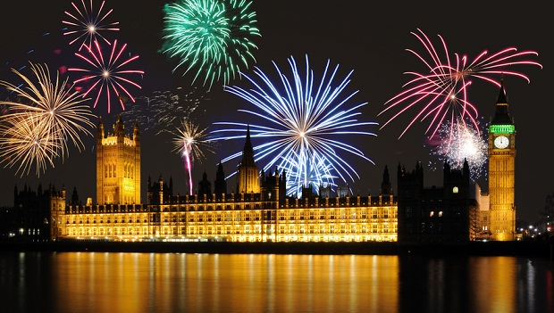
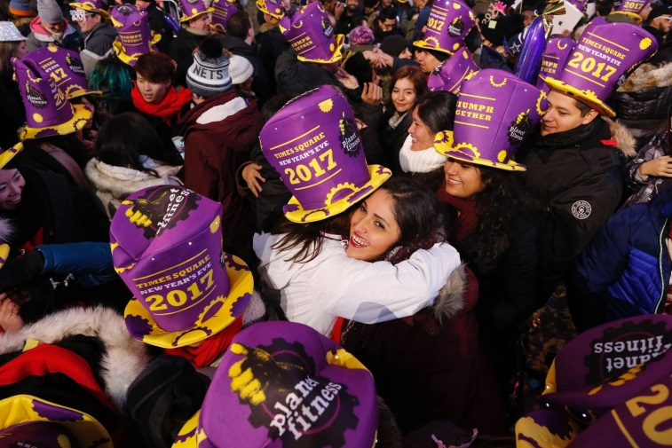
Confetti fell, fireworks went off , a lot of people gathered in New York City and in London for New Year’s Eve

